Slide 1
SAS PROJECT – Retail Sales Analysis
Presentation by: Ali A. Nathani
Date: February 18, 2020

Slide 2
Presentation Outline
Background/Introduction
Objectives
Research Question(s)/Hypothesis(es)
Methodology/Inclusion/Exclusion/Definition
Conceptual Framework/Variables of the study
Descriptive Analysis :Uni/Bi/Multi variate Analysis
Results/findings
Conclusions
Recommendations
Appendix/Tables/Graph
SAS Scripts/Procedures/Graphs

Slide 3
Background / Introduction
Retail store customers’ transactional data were recorded from Apr,2007 to May,2008
to analyze various different products on Different dates, with 8 variables about the data in one Data Set and
to utilize some of the variables from the second Data Set with Electronic products with the category EC90, having 11 variables.
More information about the variables in both Data Sets, including no. of observations and the variables can be found in the table within Appendix by clicking the arrow below:
Data Set Info

Slide 4
Business Objectives
To find the variables/factors that had the most effect on quantity or sales during 2007 - 2008
To infer the probability of a location, City or Province to be among the most popular or average range of Quantity sold or average range of Sales
To infer the probability of a Source: Web, Regular, IVR, etc. to be among the most popular or average range of Quantity sold or average range of Sales

Slide 5
Research Questions / Hypothesis
1. What was the effect of the Variables on quantity or sales during 2007 - 2008?
Hypothesis
There was an association between Province and Quantity Sold
There was an association between Province and Sum of Sales
There was an association between City and Quantity Sold
There was an association between City and Sum of Sales
There was an association between Order Month, Source and Sum of Sales
There was an association between Order Year, Source and Sum of Sales

Slide 6
Methodology
Data cleansing/Validation
Data Preparation
Statistical Procedures
Descriptive Data Analysis
Using SAS 9.4

Slide 7
Methodology – Data cleansing / Validation
Remove the Duplicate records that were found
Exclude the 6 records that have a Quantity = 0 as it will not be needed in the analysis
Count missing values for all categories and remove unnecessary categories
Data Cleaning

Slide 8
Methodology – Data Preparation
Create the Sales Variable
Find the Customer_ID in the EC90 Data Set and
Include: the City, Prov & Postal Code for each customer in the first Data Set
Calculate Total Sales, Total Orders by Province and City, by Year, by Month for each Year
Data Cleaning

Slide 9
Methodology – Statistical Procedures
Use the Statistical Procedures that best describes the variables that have the most effect on the target, i.e. Sales or Quantity sold
Procedures – Sort, Frequency, Mean, Mode, Univariate
Inferential Statistics – Test using Chi-Square at a signifiance of 0.05

Slide 10
Conceptual Framework - 1
Independent Variables
Dependent Variables
Province
City
Total
Sales Amount

Slide 11
Conceptual Framework - 2
Independent Variables
Dependent Variables
Order Month
Total
Sales Amount
Source
Order Year

Slide 12
Variables of Study -Definitions
Independent Variables: Province – Location of Purchase/Purchaser Province, also location of Delivery might be the same City – Same as above Order Month – Month in which purchase was made. Generated from Order Date Order Year – Year in which purchase was made. Generated from Order Date Source – Includes all channels: Web, Regular, IVR and some Other categories
Dependent Variables (Calculated) Total Sales Amount

Slide 13
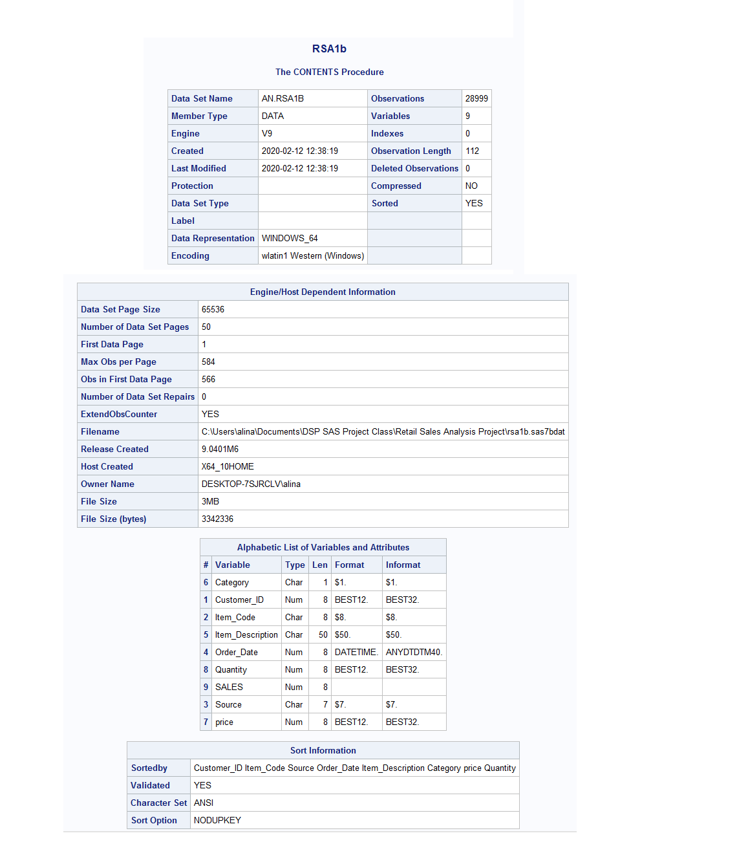
Summary of Variables

Slide 14
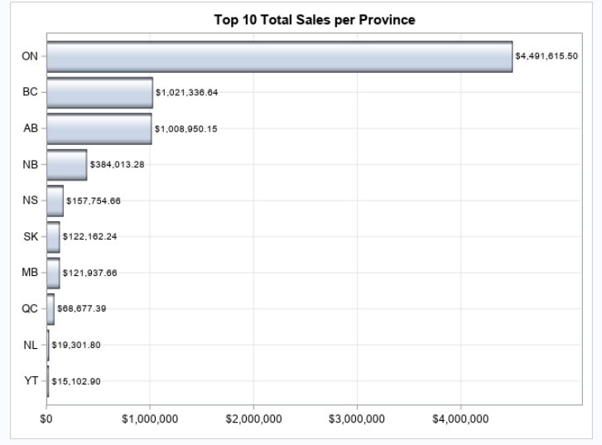
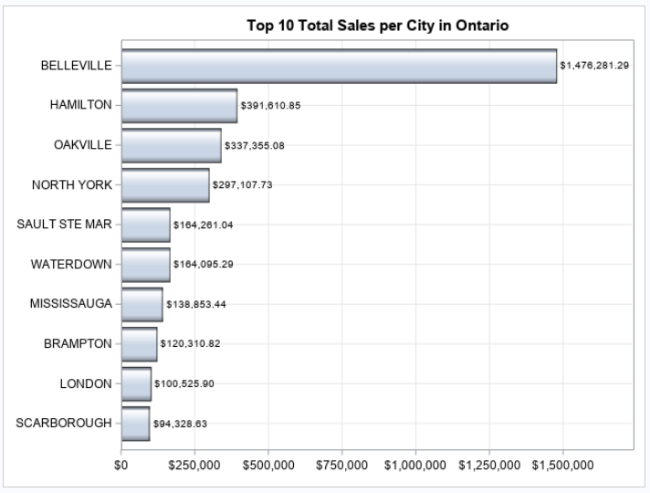
Descriptive Data Analysis
Sales by region,
The Analysis shows that ON has the highest no. of Sales @ $14,491,615.50
The City within Ontario with the highest sales was Belleville

Slide 15
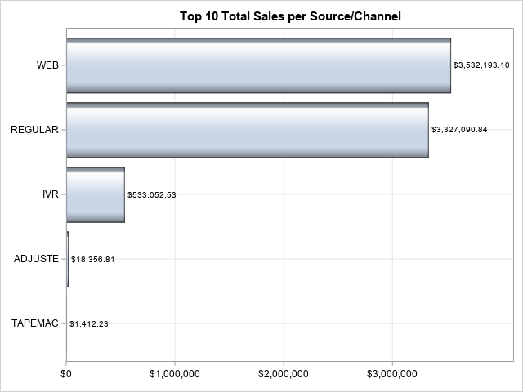
Descriptive Data Analysis
Sales by channel,
The Analysis shows that the WEB was the channel with the highest Sales @$3,532,193.10
The close second channel being REGULAR @$3,327,090.84

Slide 16
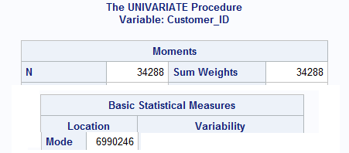
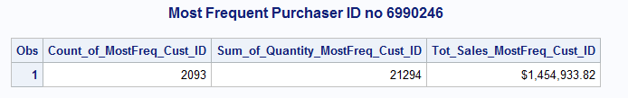
Descriptive Data Analysis
Sales per customer,
Customer ID # 6990246 had the highest orders and Sales

Slide 17
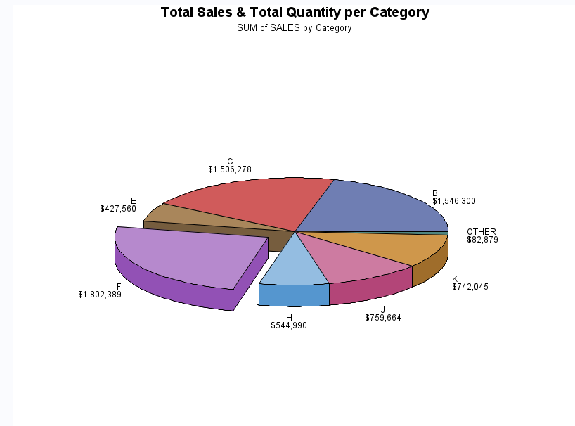
Descriptive Data Analysis
Product Sales per category,
The Analysis shows that Category ‘F’ had the highest Sales
Category ‘F’ is Fashion Products

Slide 18
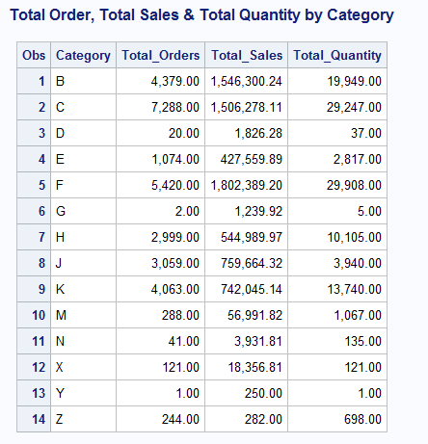
Descriptive Data Analysis

Slide 19
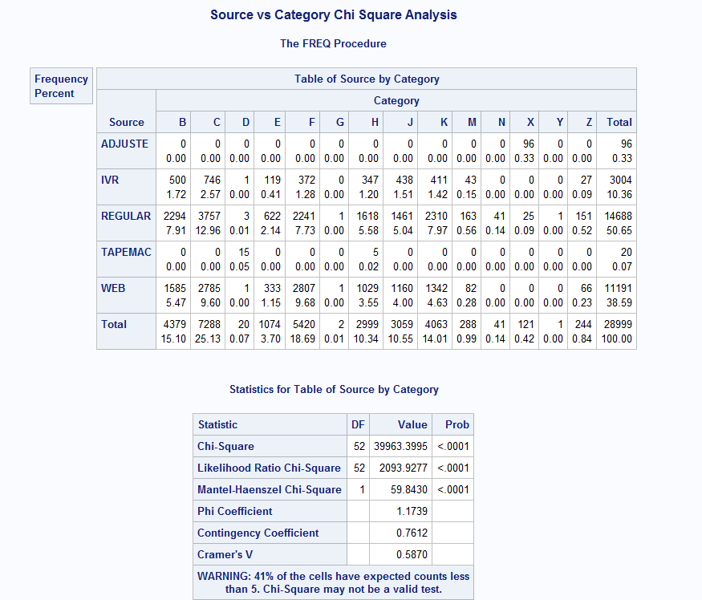
Descriptive Data Analysis

Slide 20
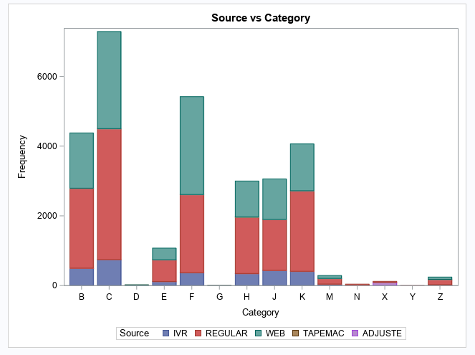
Descriptive Data Analysis
No of Orders Per Category Grouped
By Source/Channel
The Analysis shows that Category C
Had the most no of orders and was
Close between the REGULAR and
WEB channels

Slide 21
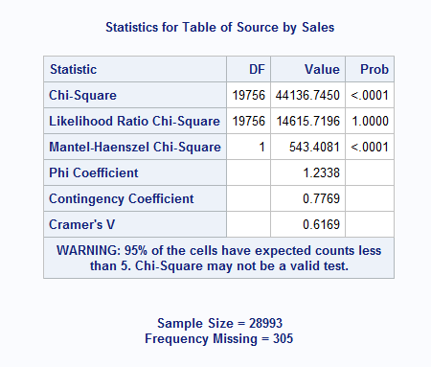
Chi-Square Analysis
Chi-Square Analysis of Source
By Sales
The Analysis shows that the Probability
is below the significance level of 0.05,
Therefore, we can reject the
Null Hypothesis and conclude that
there is a possibility of a relationship
Between Source and Sales

Slide 22
Summary of Findings
Ontario was the highest in Sales and within Ontario, city of Belleville had the highest sales
The WEB and REGULAR channels were close in terms of highest Sales
Customer ID # 6990246 had the highest orders and Sales
Category ‘F’ had the highest Sales (Fashion Products)
There is a possibility of a relationship between Source and Sales

Slide 23
Recommendations
Continue to concentrate on the ONTARIO Region
Increase promotions using the WEB channel
Promote more Fashion products while building on other products

Slide 24
THANK YOU !!

Slide 25
APPENDIX
Tables
Summary of Variables
Info on 2 Data Sets
Data Cleansing/Prep
Other Analysis Charts
SAS CODE

Slide 26
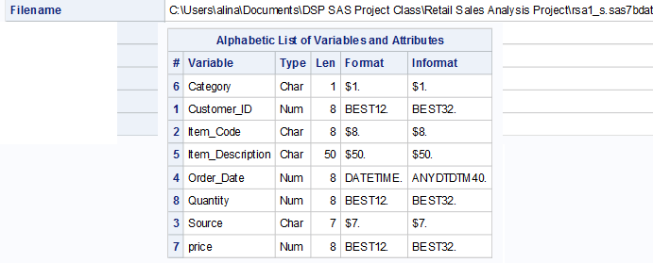
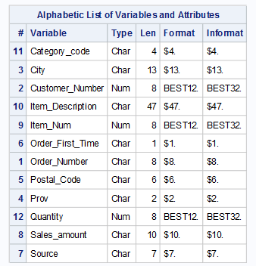
Tables: - Info on 2 Data Sets
Background Info
2 Data sets were recorded with the following:
DATA SET 1
DATA SET 2

Slide 27
Tables: - Info on 2 Data Sets
Background Info
2 Data sets were recorded with the following:
Info: | Data Set 1 | Data Set 2
No. Of Records | 34,288 | 1,297
Type of Products | Variety of different products | Electronics category EC90 only: Acer Aspire 16" Multimedia Notebook Computer
Demographics: Location Info: | No Location information | City, Province and Postal Code
Different Order Details | Order Date | Order_Number, Order_First_Time (Y/N)
Sales information | Price & Quantity | Sales_Amount & Quantity
Common | Customer_ID, Item_Code, Source, Item_Description, Category, Quantity | Customer_Number, Source, Item_Num, Item_Description, Category_code, Quantity

Slide 28
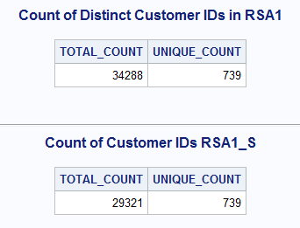
Tables- Data Cleansing/Prep
Methodlogy

Slide 29
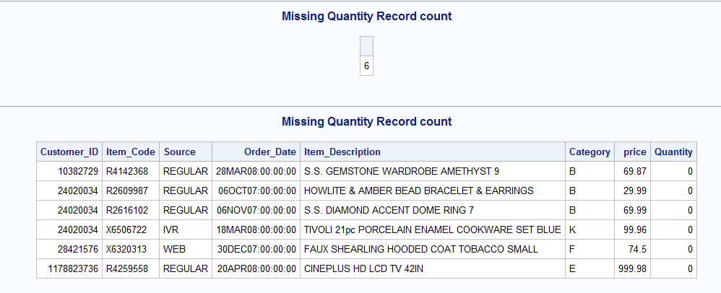
Tables- Data Cleansing/Prep
Methodlogy

Slide 30
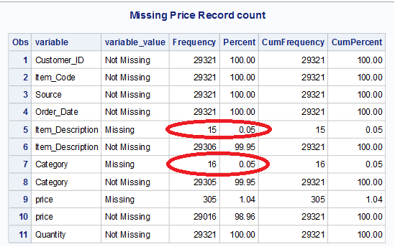
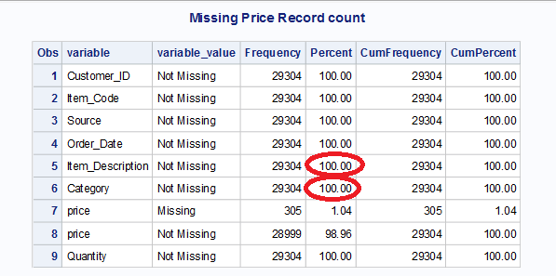
Tables- Data Cleansing/Prep
Methodlogy

Slide 31
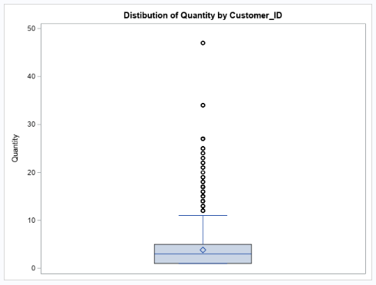
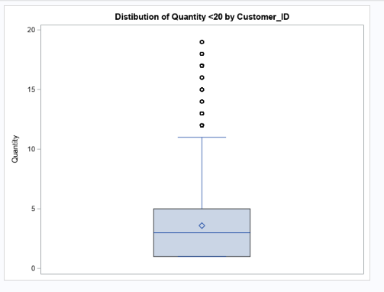
Other Analysis Charts
The above shows the spread of the Total Quantity purchased by each Customer.
The second graph has been scaled down to better understand the Range

Slide 32
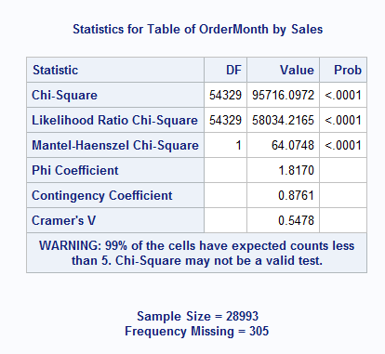
Other Analysis Charts

Slide 33
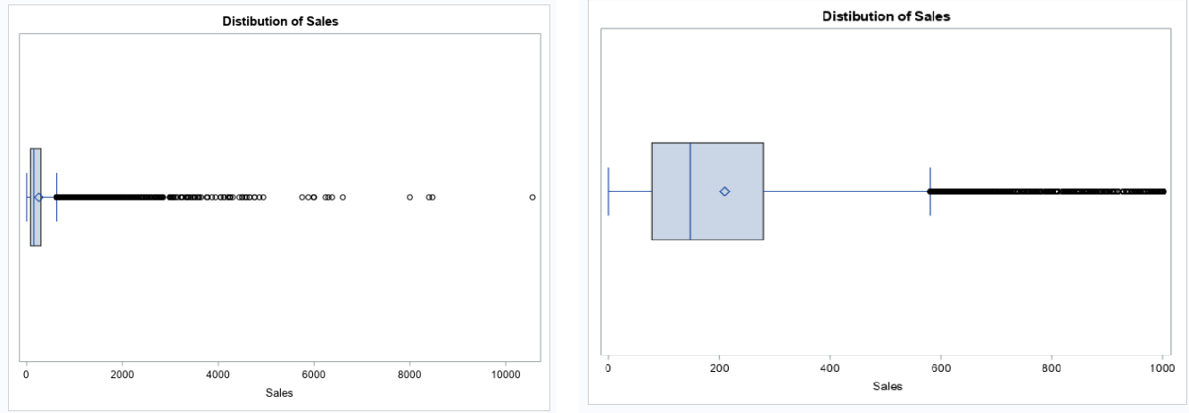
Other Analysis Charts
The above shows the spread of the Total Sales by each Customer.
The second graph has been scaled down to better understand the Range

Slide 34
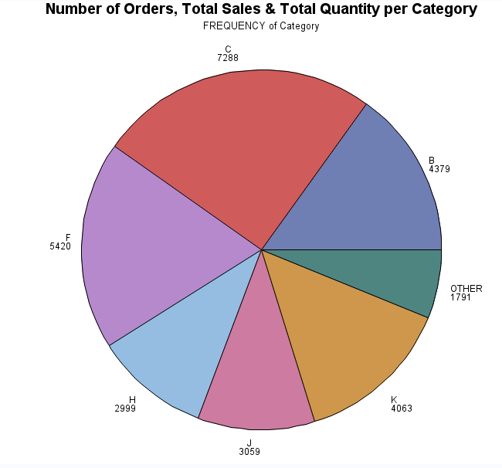
Other Analysis Charts

Slide 35
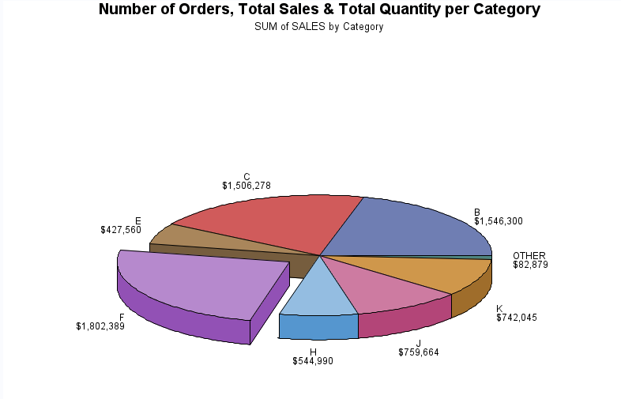
Other Analysis Charts

Slide 36
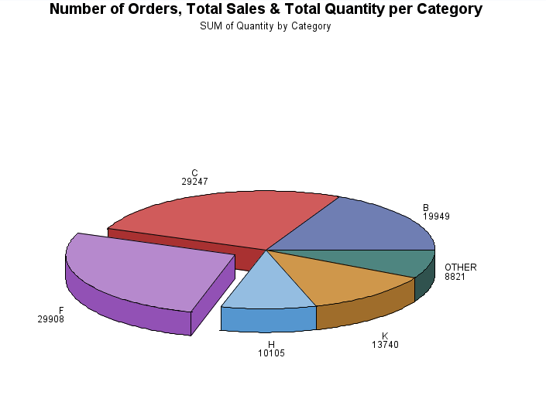
Other Analysis Charts

Slide 37
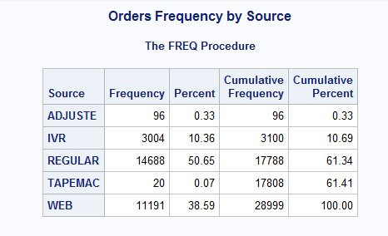
Other Analysis Charts

Slide 38
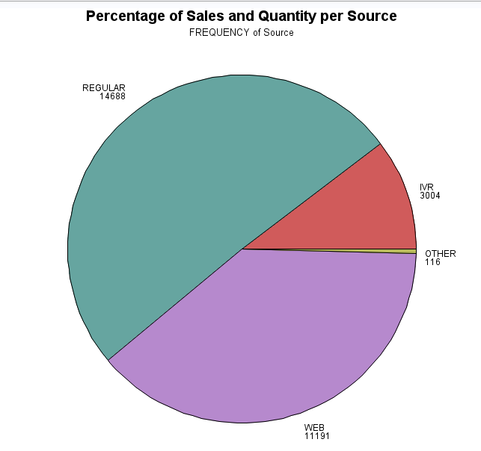
Other Analysis Charts

Slide 39
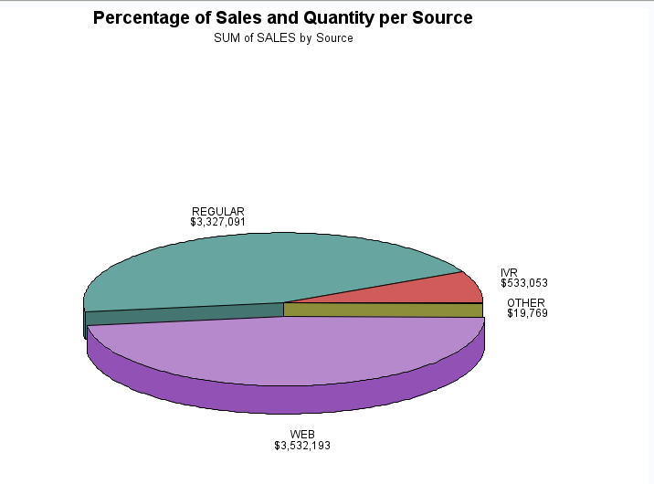
Other Analysis Charts

Slide 40
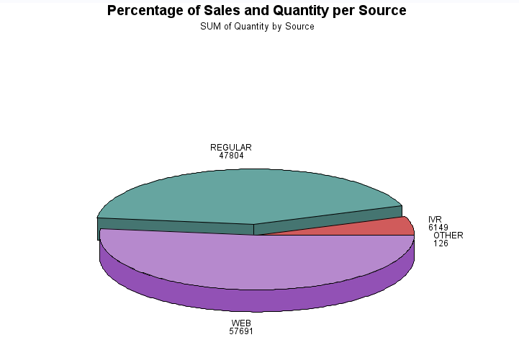
Other Analysis Charts

Slide 41
SAS SCRIPTS
libname AN "F:\DSP SAS Project Class\Retail Sales Analysis Project";
libname AN "C:\Users\alina\Documents\DSP SAS Project Class\Retail Sales Analysis Project";
libname AN "C:\Users\anathani\Desktop\DSP SAS Project class\Retail Sales Analysis Project";
libname AN "F:\DSP SAS Project Class\Retail Sales Analysis Project";
libname AN "E:\DSP SAS Project Class\Retail Sales Analysis Project";
libname AN "C:\Users\alina\Documents\DSP SAS Project Class\Retail Sales Analysis Project";
/*STEP 1*/
*import data to SAS;
PROC IMPORT OUT= AN.RSA1
DATAFILE= "C:\Users\alina\Documents\DSP SAS Project Class\Retail Sales Analysis Project\transactionhistoryforcurrentcustomers.csv"
DBMS=CSV REPLACE;
GETNAMES=YES;
DATAROW=2;
RUN;
*import the 2nd dataset;
PROC IMPORT OUT= AN.RSA2
DATAFILE= "C:\Users\alina\Documents\DSP SAS Project Class\Retail Sales Analysis Project\ec90_data.csv"
DBMS=CSV REPLACE;
GETNAMES=YES;
DATAROW=2;
RUN;
/*---------------------------------------------------------------------*/
*RSA 1 - TRANSACTIONAL DATA SET WITH VARIOUS DIFFERENT PRODUCTS;
/*STEP 2----------------------------------------------------------------*/
*DATA PREPARATION;
*DATA VALUE;
PROC PRINT DATA = AN.RSA1 (OBS = 20);
TITLE "RSA1";
RUN;
*DUPLICATES;
*COUNT COLS;
TITLE "Count of Distinct Customer IDs in RSA1";
PROC SQL;
SELECT COUNT(Customer_ID)AS TOTAL_COUNT, COUNT(DISTINCT Customer_ID) AS UNIQUE_COUNT
FROM AN.RSA1
;
QUIT;
*REMOVE DUPLICATE OBSERVATIONS and check count again;
PROC SORT DATA = AN.RSA1 OUT = AN.RSA1_S dupout=AN.RSA1aDup NODUPRECS;
BY _ALL_;
RUN;

Slide 42
SAS SCRIPTS
*list the duplicate records - STEP NOT REQUIRED;
/*PROC SQL;*/
/*SELECT * FROM AN.RSA1aDup;*/
/*QUIT;*/
/*PROC PRINT; RUN;*/
*COUNT AGAIN;
TITLE 'Count of Customer IDs RSA1_S';
PROC SQL;
SELECT COUNT(Customer_ID)AS TOTAL_COUNT, COUNT(DISTINCT Customer_ID) AS UNIQUE_COUNT
FROM AN.RSA1_s
;
QUIT;
*UNDERSTAND YOUR DATA AND ITS PROPERTIES;
TITLE "Contents RSA1_s";
PROC CONTENTS DATA = AN.RSA1_S;
RUN;
TITLE "Univariate Analysis RSA1_S";
PROC UNIVARIATE DATA = AN.RSA1_S;
RUN;

Slide 43
SAS SCRIPTS
*checking records for quantity = 0;
title 'Missing Quantity Record count';
PROC SQL;
SELECT count(*) FROM AN.RSA1_S
WHERE Quantity = 0;
quit;
PROC SQL;
SELECT * FROM AN.RSA1_S
WHERE Quantity = 0;
quit;
/*LEAVING THE ABOVE QUANTITY RECORDS AS THEY ARE ONLY 6 AND WILL NOT AFFECT THE ANALYSIS*/
*checking records for price = .;
title 'Missing Price Record count';
PROC SQL;
SELECT count(*) FROM AN.RSA1_S
WHERE Price = .;
quit;
PROC SQL OUTOBS=10;
SELECT * FROM AN.RSA1_S
WHERE Price = .;
quit;

Slide 44
SAS SCRIPTS
/*LEAVING THE ABOVE RECORDS AS IT WILL BE A SEPARATE CATEGORY FOR FREE OR PROMOTIONAL PRODUCTS*/
*checking records for missing category ;
title 'Missing Category Record count';
PROC SQL;
SELECT count(*) FROM AN.RSA1_S
WHERE Category = " ";
quit;
*count missing values for all categorical variables;
*create format for missing;
proc format ;
value $ missfmt ' '="Missing" other="Not Missing";
value nmissfmt .="Missing" other="Not Missing";
run;
*Proc freq to count missing/non missing;
ods table onewayfreqs=temp;
proc freq data=AN.RSA1_S;
table _all_ / missing;
format _numeric_ nmissfmt. _character_ $missfmt.;
run;

Slide 45
SAS SCRIPTS
*Format output;
data want;
length variable $32. variable_value $50.;
set temp;
Variable=scan(table, 2);
Variable_Value=strip(trim(vvaluex(variable)));
keep variable variable_value frequency percent cum:;
label variable='Variable' variable_value='Variable Value';
run;
proc print data = want;
run;
data AN.RSA1_NoMiss;
set AN.RSA1_S;
if Category = ' ' then delete;
if Item_Description = ' ' then delete;
run;
*COUNT MISSING AGAIN;
ods table onewayfreqs=temp;
proc freq data=AN.RSA1_NoMiss;
table _all_ / missing;
format _numeric_ nmissfmt. _character_ $missfmt.;
run;

Slide 46
SAS SCRIPTS
*Format output;
data want2;
length variable $32. variable_value $50.;
set temp;
Variable=scan(table, 2);
Variable_Value=strip(trim(vvaluex(variable)));
keep variable variable_value frequency percent cum:;
label variable='Variable' variable_value='Variable Value';
run;
proc print data = want2;
run;
/*STEP 3----------------------------------------------------------------*/
*FEATURE GENERATION/ENGINEERING;
*JOIN LOCATION DATA FROM EC90 into a MASTER DATASET;
proc sql;
create table AN.rsa2_some as
select distinct city, customer_number, postal_code, prov
from AN.rsa2;
quit;
proc sql;
create table master as
select x.*, y.City, y.Prov, y.Postal_Code, x.Quantity * x.Price AS Sales
from AN.RSA1_NoMiss x left join AN.rsa2_some y
on x.customer_id=y.customer_number
where x.Quantity NE 0;
;
quit;

Slide 47
SAS SCRIPTS
TITLE "Master Dataset Univariate Analysis";
PROC UNIVARIATE DATA = Master;
RUN;
/*STEP 4----------------------------------------------------------------*/
*UNIVARIATE ANALYSIS OR DESCRIPTIVE / EXPLORATORY DATA ANALYSIS;
*Distribution of Quantity;
proc sgplot data = Master;
vbox Quantity ;
title 'Distibution of Quantity by Customer_ID';
run;
proc sgplot data = Master;
vbox Quantity ;
title 'Distibution of Quantity <20 by Customer_ID';
Where Quantity <20;
run;
*Distribution of Sales ;
proc sgplot data = Master;
hbox Sales;
title 'Distibution of Sales ';
run;

Slide 48
SAS SCRIPTS
proc sgplot data = Master;
hbox Sales;
title 'Distibution of Sales ';
Where sales <1000;
run;
*distribution of price;
proc sgplot data = Master;
vbox Price ;
title 'Distibution of Price';
run;
*checking frequency of mode of CUSTOMER ID, Sum of the Quantity;
TITLE 'Most Frequent Purchaser ID no 6990246';
PROC SQL;
create table MOST_FREQ_CUST_ID AS
SELECT COUNT(Customer_ID) AS Count_of_MostFreq_Cust_ID, SUM(Quantity) AS Sum_of_Quantity_MostFreq_Cust_ID, Sum(Price*Quantity) format=dollar13.2 AS Tot_Sales_MostFreq_Cust_ID
FROM Master
WHERE Customer_ID = 6990246
;
QUIT;
PROC PRINT; RUN;

Slide 49
SAS SCRIPTS
/*STEP 5----------------------------------------------------------------*/
*BIVARIATE ANALYSIS;
*orders per customer by Province;
proc sql;
create table totalcount_cust_id as
select count(customer_ID) AS TOTAL_ORDERS_PER_CUSTOMER, Prov
FROM Master
group by Prov
order by TOTAL_ORDERS_PER_CUSTOMER DESC
;
quit;
title 'Total Orders per Province';
proc sgplot data=totalcount_cust_id ;
hbar Prov / response=TOTAL_ORDERS_PER_CUSTOMER dataskin=gloss datalabel
categoryorder=respdesc nostatlabel;
xaxis grid display=(nolabel);
yaxis grid discreteorder=data display=(nolabel);
run;
quit;

Slide 50
SAS SCRIPTS
*orders per customer by city in Ontario;
proc sql OUTOBS = 10;
create table totalcount_ontariocity as
select count(customer_ID) AS TOTAL_ORDERS_PER_CUSTOMER, City
FROM Master
where Prov = 'ON'
group by City
order by TOTAL_ORDERS_PER_CUSTOMER DESC
;
quit;
title 'Top 10 Total Orders per City in Ontario';
proc sgplot data=totalcount_ontariocity ;
hbar City / response=TOTAL_ORDERS_PER_CUSTOMER dataskin=matt datalabel
categoryorder=respdesc nostatlabel;
xaxis grid display=(nolabel);
yaxis grid discreteorder=data display=(nolabel);
run;
quit;
*sales per province;
proc sql OUTOBS = 10;
create table totalsales_PROV as
select sum(Sales) format dollar13.2 AS TOTAL_SALES_PER_PROV, Prov
FROM Master
group by Prov
order by TOTAL_SALES_PER_PROV DESC
;
quit;

Slide 51
SAS SCRIPTS
title 'Top 10 Total Sales per Province';
proc sgplot data=totalsales_PROV ;
hbar Prov / response=TOTAL_SALES_PER_PROV dataskin=gloss datalabel
categoryorder=respdesc nostatlabel;
xaxis grid display=(nolabel);
yaxis grid discreteorder=data display=(nolabel);
run;
quit;
*sales by city in Ontario;
proc sql OUTOBS=10;
create table totalsales_ontariocity as
select sum(Sales) format dollar13.2 AS TOTAL_SALES_PER_CITY, City
FROM Master
where Prov = 'ON'
group by City
order by TOTAL_SALES_PER_CITY DESC
;
quit;
title 'Top 10 Total Sales per City in Ontario';
proc sgplot data=totalsales_ontariocity ;
hbar City / response=TOTAL_SALES_PER_CITY dataskin=gloss datalabel
categoryorder=respdesc nostatlabel;
xaxis grid display=(nolabel);
yaxis grid discreteorder=data display=(nolabel);
run;
quit;

Slide 52
SAS SCRIPTS
*sales by channel in Ontario;
proc sql OUTOBS=10;
create table totalsales_channel as
select sum(Sales) format dollar13.2 AS TOTAL_SALES_PER_CHANNEL, Source
FROM Master
group by Source
order by TOTAL_SALES_PER_CHANNEL DESC
;
quit;
title 'Top 10 Total Sales per Source/Channel';
proc sgplot data=totalsales_channel ;
hbar Source / response=TOTAL_SALES_PER_CHANNEL dataskin=gloss datalabel
categoryorder=respdesc nostatlabel;
xaxis grid display=(nolabel);
yaxis grid discreteorder=data display=(nolabel);
run;
quit;
TITLE "Percentage of Sales and Quantity per Source/Channel";
PROC GCHART DATA = Master;
format sales dollar20.;
PIE Source ;
RUN;
pie3d Source / sumvar=Sales
explode="WEB";
run;
pie3d Source / sumvar=Quantity
explode="REGULAR";
run;
quit;

Slide 53
SAS SCRIPTS
*order date;
proc sql ;
create table Master2 as
select *, month(datepart(Order_Date)) as OrderMonth, year(datepart(Order_Date)) as OrderYear
from Master
;
quit;
Proc Format;
Value YearT 2007 = "2007"
2008 = "2008"
;
Run;
proc sql;
create table totalsales_year as
select sum(Sales) format dollar13.2 AS TOTAL_SALES_PER_YEAR, OrderYear
FROM Master2
group by OrderYear
order by TOTAL_SALES_PER_YEAR DESC
;
quit;

Slide 54
SAS SCRIPTS
/**pie chart;*/
TITLE "Total sales per year";
PROC GCHART DATA = totalsales_year;
format OrderYear YearT.;
pie3d OrderYear / sumvar=TOTAL_SALES_PER_YEAR
;
run;
quit;
title 'Total Sales Per Year';
proc sgplot data=totalsales_year ;
vbar OrderYear / response=TOTAL_SALES_PER_YEAR dataskin=gloss datalabel
categoryorder=respdesc nostatlabel;
xaxis grid display=(nolabel);
yaxis grid discreteorder=data display=(nolabel);
run;
quit;

Slide 55
SAS SCRIPTS
*sales by Month in 2007;
proc format;
value monthlabel 1 = "Jan"
2 = "Feb"
3 = "Mar"
4 = "Apr"
5 = "May"
6 = "Jun"
7 = "Jul"
8 = "Aug"
9 = "Sep"
10 = "Oct"
11 = "Nov"
12 = "Dec"
;
run;
proc sql;
create table totalsales_month2007 as
select sum(Sales) format dollar13.2 AS TOTAL_SALES_PER_MONTH, OrderMonth format monthlabel. as OrderMonth
FROM Master2
where OrderYear = 2007
group by OrderMonth
order by TOTAL_SALES_PER_MONTH DESC
;
quit;

Slide 56
SAS SCRIPTS
title 'Total Sales per month in 2007';
proc sgplot data=totalsales_month2007 ;
hbar OrderMonth / response=TOTAL_SALES_PER_MONTH dataskin=gloss datalabel
categoryorder=respdesc nostatlabel;
xaxis grid display=(nolabel);
yaxis grid discreteorder=data display=(nolabel);
run;
quit;
*sales by Month in 2008;
proc sql;
create table totalsales_month2008 as
select sum(Sales) format dollar13.2 AS TOTAL_SALES_PER_MONTH, OrderMonth format monthlabel. as OrderMonth
FROM Master2
where OrderYear = 2008
group by OrderMonth
order by TOTAL_SALES_PER_MONTH DESC
;
quit;
title 'Total Sales per Month in 2008';
proc sgplot data=totalsales_month2008 ;
hbar OrderMonth / response=TOTAL_SALES_PER_MONTH dataskin=gloss datalabel
categoryorder=respdesc nostatlabel;
xaxis grid display=(nolabel);
yaxis grid discreteorder=data display=(nolabel);
run;

Slide 57
SAS SCRIPTS
*----------------------------;
*total sales per Source in 2007;
proc sql;
create table sales_month2007 as
select Source, sum(Sales) as TOTAL_SALES_PER_SOURCE format dollar13.2, OrderMonth format monthlabel. as OrderMonth
FROM Master2
where OrderYear = 2007
group by OrderMonth, Source
;
quit;
title 'Total Sales per month by Source in 2007';
proc sgplot data=sales_month2007 ;
vbar OrderMonth / response=TOTAL_SALES_PER_SOURCE group=Source seglabel groupdisplay=stack
dataskin=pressed stat=sum datalabel
categoryorder=respdesc nostatlabel
baselineattrs=(thickness=0)
outlineattrs=(color=cx3f3f3f);;
xaxis grid display=(nolabel);
yaxis grid discreteorder=data display=(nolabel);
run;
quit;
*2008;
proc sql;
create table sales_month2008 as
select Source, sum(Sales) as TOTAL_SALES_PER_SOURCE format dollar13.2, OrderMonth format monthlabel. as OrderMonth
FROM Master2
where OrderYear = 2008
group by OrderMonth, Source
;
quit;

Slide 58
SAS SCRIPTS
title 'Total Sales per month by Source in 2008';
proc sgplot data=sales_month2008 ;
hbar OrderMonth / response=TOTAL_SALES_PER_SOURCE group=Source seglabel groupdisplay=stack
dataskin=pressed stat=sum datalabel
categoryorder=respdesc nostatlabel
baselineattrs=(thickness=0)
outlineattrs=(color=cx3f3f3f);;
xaxis grid display=(nolabel);
yaxis grid discreteorder=data display=(nolabel);
run;
quit;
/*change variables to bin them*/
*change quantity into categories;
proc format ;
VALUE Quantities
0 = 'FREE PROMO'
1-5 = 'SMALL '
6-10 = 'MEDIUM '
10- high = 'HIGH '
;
RUN;
PROC FREQ DATA = Master order=data;
title 'Frequency Distibution of Quantity ';
format Quantity Quantities.;
tables Quantity;
run;
/**/
*change sales into categories;
proc format ;
VALUE SalesDist
1-150 = 'LOW '
151-300 = 'MEDIUM'
300- high = 'HIGH '
;
RUN;
PROC FREQ DATA = Master order=data;
title 'Frequency Distibution of Sales ';
format Sales SalesDist.;
tables Sales;
run;
*TOTAL SALES PER CATEGORY OR PRODUCTS AND SALES PER CATEGORY;
proc print data = Master;
TITLE 'Total Sales & Total Quantity by Category'; run;
TITLE "Total Sales & Total Quantity per Category";
PROC GCHART DATA = AN.RSA1b;
format sales dollar20.;
pie3d Category / sumvar=Sales
explode="F";
run;
pie3d Category / sumvar=Quantity
explode="F";
run;
quit;
PROC FREQ DATA = Master2;
TITLE 'Order Month by Sourcevs Sales Chi Square Analysis';
TABLE OrderMonth* Sales/CHISQ NOROW NOCOL ; *CAN KEEP PERCENT, DO NOT INCLUDE NOPERCENT OR USE NOFREQ FOR ONLY PERCENT;
RUN;
*chi square analysis;
proc sql;
create table master3 as
select * from master2
where Source = 'WEB';
run;
PROC FREQ DATA = Master2;
TITLE 'Source vs Sales Chi Square Analysis';
TABLE Source* Sales/CHISQ NOROW NOCOL ; *CAN KEEP PERCENT, DO NOT INCLUDE NOPERCENT OR USE NOFREQ FOR ONLY PERCENT;
RUN;
*---------------------;
*RSA 2 - EC90 DATA SET WITH 1 main product;
*STACKED BAR CHART;
PROC SGPLOT DATA = Master2;
TITLE 'OrderMonth vs Sales';
VBAR OrderMonth/GROUP=SOURCE;
RUN;
PROC CONTENTS DATA = AN.RSA2;
run;

